Slide 1
Simulink PLC Coder Generate IEC 61131-3 Structured Text and Ladder Diagrams for PLCs and PACs

Slide 2
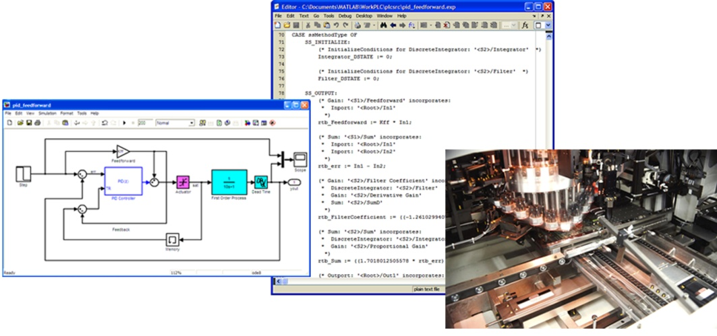
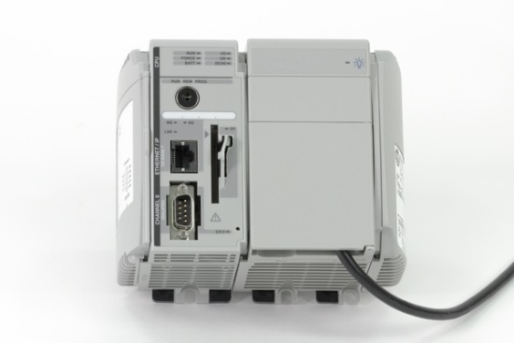
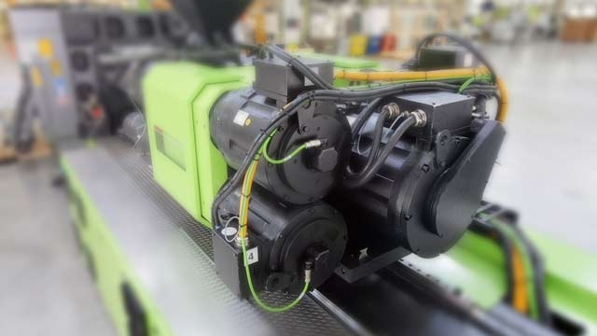
Generate Structured Text
Generate IEC 61131-3 Structured Text from
Simulink models
Stateflow charts
MATLAB code
Generate Structured Text for
Rockwell Automation Studio 5000
Siemens STEP 7/TIA Portal
3S CODESYS
Many other IDEs and PLCs
Generates test benches
Verify generated Structured Text using PLCs/PACs

Slide 3
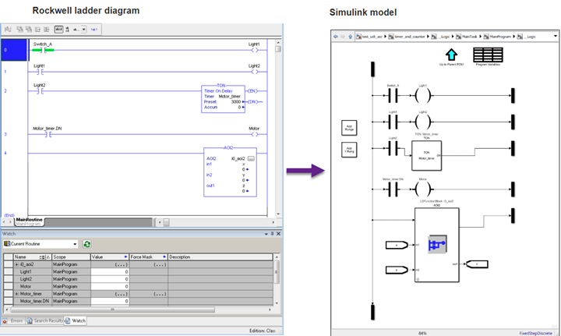
Ladder Diagram Import and Generation
Import Rockwell Automation Studio 5000 Ladder Diagrams into Simulink for simulation and verification
Generate Ladder Diagrams from Simulink models for Studio 5000
Validate generated Ladder Diagrams by generating and executing the test bench on PLCs or Studio 5000 emulator

Slide 4
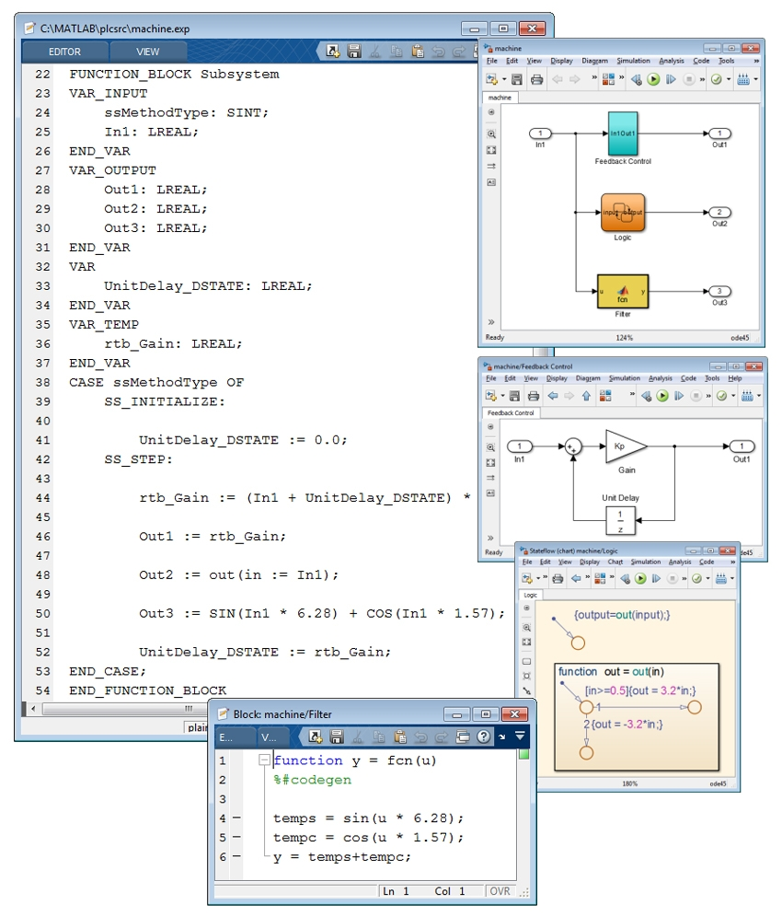
Key Features
Support for IEC 61131-3 Structured Text and Ladder Diagram
Model support including:
Simulink blocks including reusable subsystems and lookup tables
Stateflow charts including truth tables and finite state machines
MATLAB code including loops and complex math operations
Data type support including:
Boolean, enum, integer, real
Vectors, matrices, buses
Tunable parameters
Third Party IDE support
Testbench creation

Slide 5
IDE Support
Simulink PLC Coder supports IDEs including:
3S-Smart Software Solutions CODESYS
B&R Automation Studio
Beckhoff TwinCAT
Omron Sysmac Studio
Phoenix Contact MULTIPROG/PCWorx
Rexroth IndraWorks
Latest IDE support information
Simulink PLC Coder Supported IDEs
Simulink PLC Coder supports IDEs including:
Rockwell Automation RSLogix 5000 & Studio 5000
Selectron CAP1131 IDE
Siemens SIMATIC STEP 7 and TIA Portal
PLCopen XML Format
Generic File Format

Slide 6
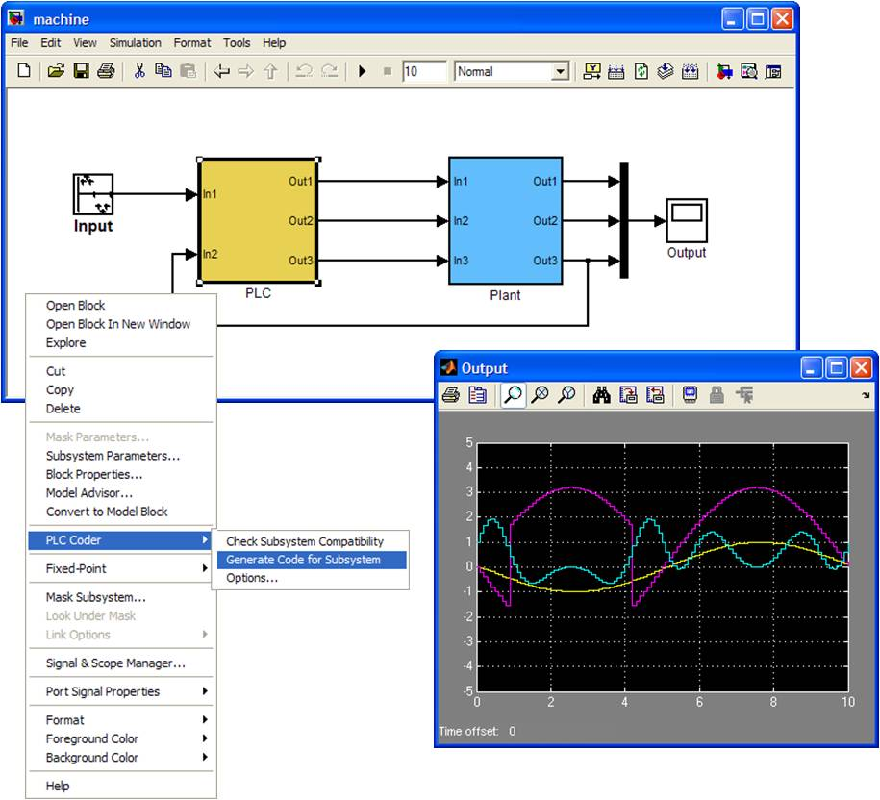
Working with Simulink PLC Coder
Simulink PLC Coder enables you to:
Embed control algorithm models onto PLCs and PACs production control systems
Right click an atomic subsystem and build
Use your IDE to deploy on PLCs
Implement plant models (discrete time) using structured text for hardware-in-the-loop testing
Alternatively, you can use Simulink Coder to generate C/C++ code for HIL testing with discrete- or continuous-time models

Slide 7
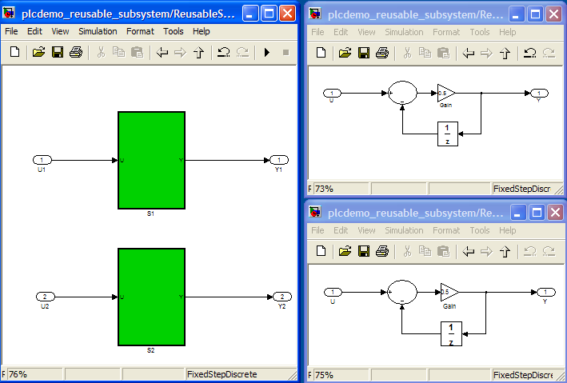
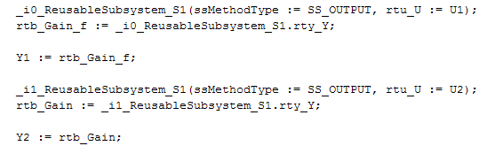
Code Optimization
Simulink PLC Coder automatically applies optimization such as:
Dead-code elimination
Expression folding
For-loop fusion
Inline vs tunable parameters
Signal storage reuse
Subsystem reuse (shown)

Slide 8
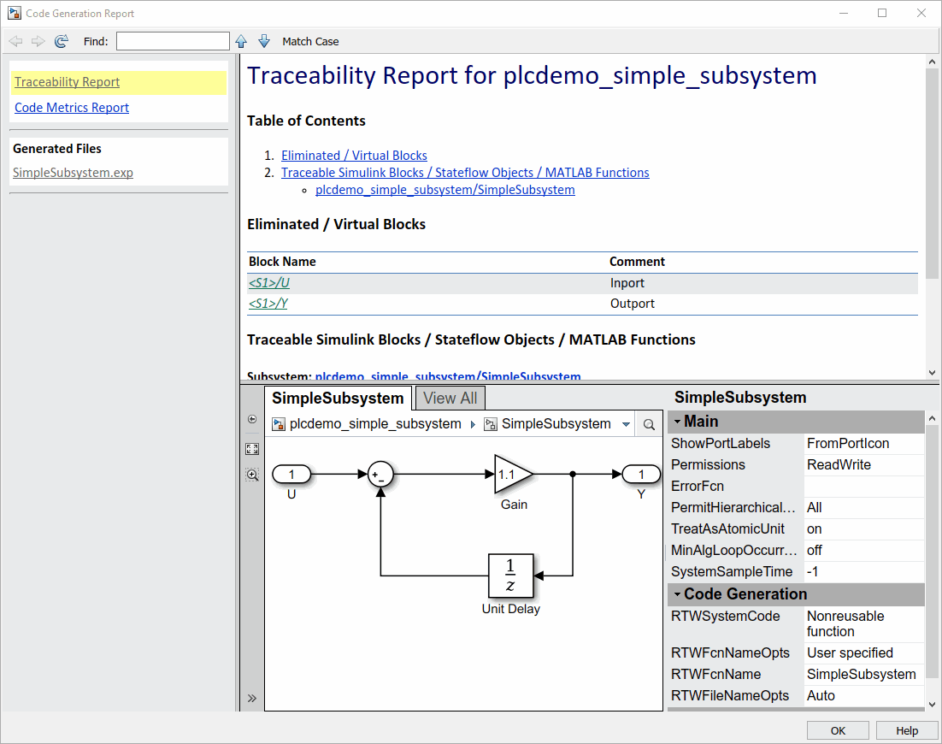
Documenting the Generated Code
Navigate and trace between Simulink model components and the generated code
Comments and user-specified block descriptions can be inserted into the generated code
Bidirectional links can be inserted into the generated code to enable traceability between model and code
View the code generation report
All information consolidated for code reviews and debugging

Slide 9
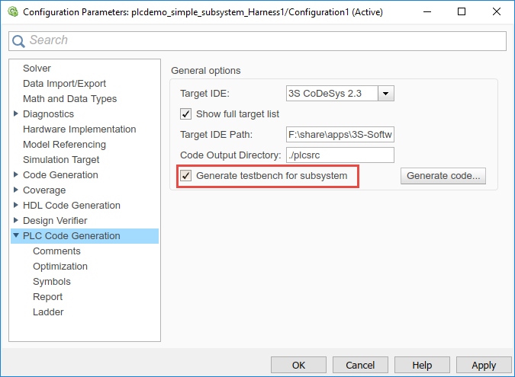
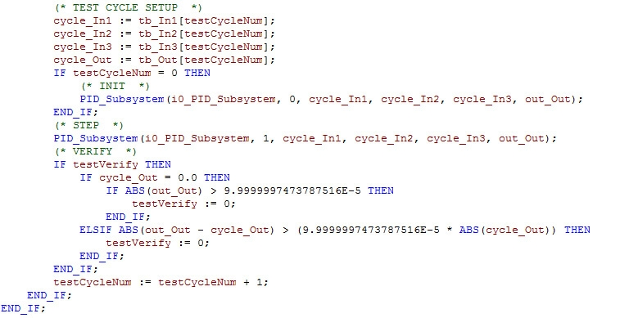
Code Test and Verification
Verify generated code behavior matches simulation behavior
Generate and import one or more test benches, input stimulus, and expected results along with the generated code into IDEs
Run test bench in IDE/PLC to verify results within an acceptable tolerance
Simulink Test integration
Author, manage, and execute simulation-based tests of the generated code
Run Hardware-in-the-loop testing
With Simulink Coder, Simulink Real-Time, and Speedgoat target computer

Slide 10
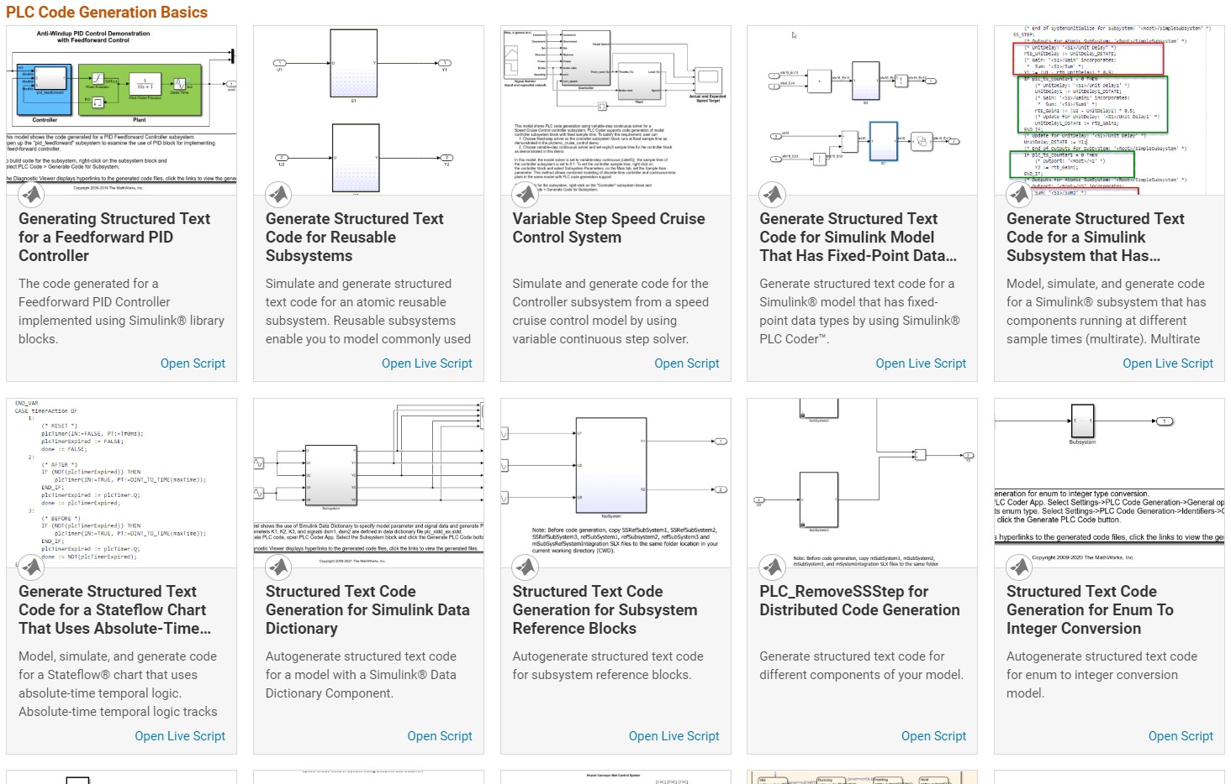
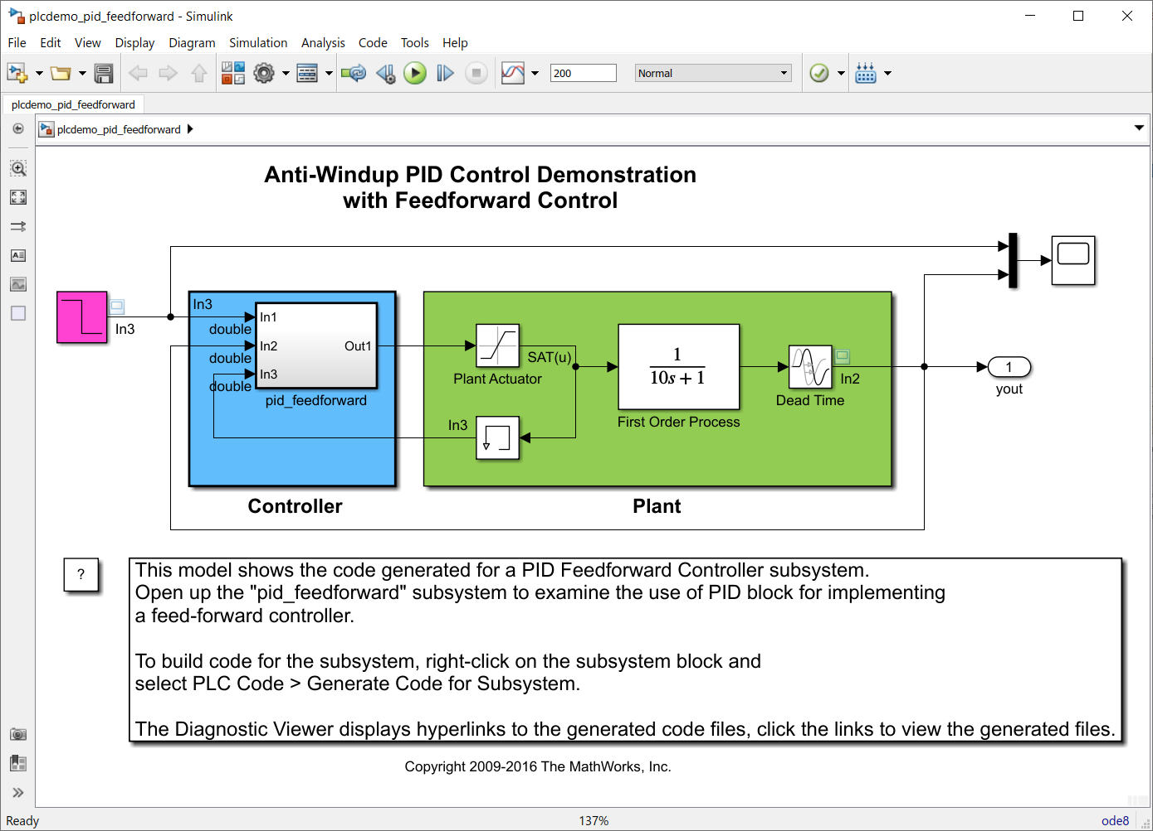
Product Demonstration
>> plccoderdemos

Slide 11
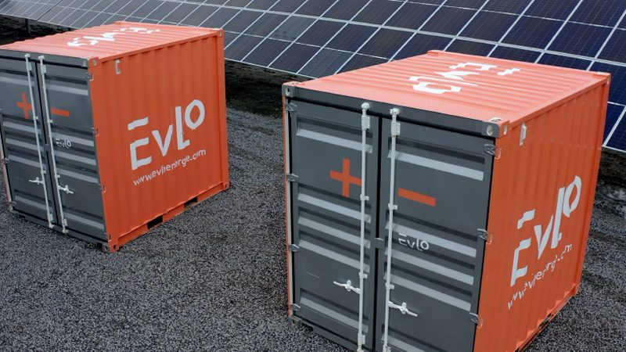
EVLO Energy Storage Accelerates Development of Energy Management Systems with Model-Based Design
Challenge
Improve the performance and extend the lifespan of large-scale energy storage systems with next-generation EMS designs
Solution
Use Model-Based Design to model EMS controllers, verify designs via simulation-based tests, and generate code for multiple targets
Results
Algorithms prototyped in hours
Reusable virtual ESS deployed
Quality continuously improved
Two EVLO 500s, part of a 4-MWh energy storage system coupled with a PV solar farm near Montreal, Canada.
“When we sell an energy storage system, our customers often need to verify that it will work on their grids, so we provide them with the same Simulink plant model that we used to develop our EMS software suite. As a result, we are able to run accurate simulations before installing any equipment on the client’s grid, and can provide this service at a competitive cost.” - Adile Ajaja, EVLO
Link to user story
Notes:
Industries: Energy Production, Industrial Automation and Machinery
Application Areas: Control Systems, Embedded Systems, Power Electronics Control Design
Capabilities: Algorithm Development, Embedded Code Generation, Mathematical Modeling, Parallel Computing, Physical Modeling, Simulation and Model-Based Design, System Design and Simulation, Verification, Validation, and Test
Products Used: MATLAB, Simulink, Embedded Coder, HDL Coder, Parallel Computing Toolbox, Requirements Toolbox, Simscape, Simscape Electrical, Simulink Coverage, Simulink PLC Coder, Simulink Test
Country: Canada
EVLO Energy Storage Accelerates Development of Energy Management Systems with Model-Based Design
Energy storage systems (ESS) play a vital role in enabling renewable energy sources to be safely and reliably integrated with the grid. These systems perform power smoothing—absorbing or injecting power as needed to reduce fluctuations that are common with wind and solar power sources, and they also perform reserve management and frequency control functions for hydroelectric sources.
Large-scale ESS incorporate multiple racks of battery cells, inverters, interconnection hardware, temperature controls, and other components. An efficient energy management system (EMS) ensures that all ESS components work well together to maximize performance and the lifespan of the entire system. Due to the complexity and difficulty of testing on real hardware, developing software for an EMS is often a time-consuming, labor-intensive process.
Engineers at EVLO, a subsidiary of Hydro-Québec, use Model-Based Design with MATLAB and Simulink to accelerate the development of EMS for utility-scale energy storage systems. “Writing—and later maintaining—code for an EMS is resource intensive; it requires a lot of manpower,” says Adile Ajaja, senior software team manager at EVLO. “With Model-Based Design we can focus on the EMS design itself, which is what provides direct value to the customer, verify the design through simulation, and then generate code for a variety of deployment options, including PLCs and embedded processors.”
Challenge
When a battery cell is charged and discharged frequently it generates heat, leading to performance degradation and diminished useful life of the cell. Although EVLO systems are designed with lithium iron phosphate cells that have greater thermal stability than lithium-ion cells, EVLO engineers need to implement intelligent control strategies that distribute charging and discharging across all available cells to minimize heat generation and its adverse effects.
Because validating and verifying control strategies directly on 500-kWh and 1-MWh ESS is not practical, EVLO needed a way to build complete plant models that incorporate available submodels from third-party component suppliers. Finally, to accelerate implementation, the team wanted to avoid handwriting code and instead generate code for a variety of target platforms.
“When we sell an energy storage system, our customers often need to verify that it will work on their grids, so we provide them with the same Simulink plant model that we used to develop our EMS software suite. As a result, we are able to run accurate simulations before installing any equipment on the client’s grid, and can provide this service at a competitive cost.”
- Adile Ajaja, EVLO
Solution
In their design workflow, EVLO engineers use Simulink® to model both the EMS controller and plant.
Working in Simulink with Stateflow®, the engineers model the controller in multiple layers: a hardware abstraction layer that provides an interface to the inverter and other EMS components, an application layer that includes power smoothing and frequency control algorithms, and an optimization layer that maximizes power efficiency and component longevity.
The engineers use Requirements Toolbox™ to link system and high-level requirements in IBM® DOORS® Next to corresponding elements of the Simulink controller model and later to test cases used to verify the requirements.
Continuing to work in Simulink, the engineers model the ESS plant and each of its components. In some cases, component suppliers provide a Simulink model that can be incorporated directly into the plant model. Otherwise, EVLO engineers model the component themselves using Simscape™ and Simscape Electrical™.
The team runs a series of simulations with the controller and plant models to verify the design. They run Model Advisor checks to ensure their models comply with high-integrity guidelines, and they use Simulink Design Verifier™ to identify division by zero and other design errors.
Using Simulink Test™, the team creates test cases based on the model simulations. The test cases are executed as part of the team’s continuous integration process on a multicore workstation using Parallel Computing Toolbox™. As the tests run,
Simulink Coverage™ analyzes model coverage and identifies untested elements of the controller model.
Depending on the target deployment hardware, the engineers generate code from the controller model using Simulink PLC Coder™ or Embedded Coder™. They also generate code from the plant model using Simulink Coder™; they then use this code for hardware-in-the-loop regression tests.
EVLO is expanding the use of Model-Based Design to other product lines, including electric vehicle charging stations, for which HDL code is generated from the model for FPGA deployment.
Results
Algorithms prototyped in hours. “With Model-Based Design, we can prototype and test an early version of our algorithm much faster than is possible with traditional methods,” says Ajaja. “In a matter of hours, we can create a fully-functional prototype that would take several days without Simulink and code generation.”
Reusable virtual ESS deployed. “We have a compiled instance of our Simulink plant model running on a virtual machine in the lab,” notes Ajaja. “That’s an advantage for us because we can use this setup instead of a real ESS to test controllers, and we can reuse it to train operators and to provide demonstrations for potential customers.”
Quality continuously improved. “Simulink supports our full development life cycle, from requirements to desktop and HIL simulations and regression tests, so we can perform every step of the V-model in a single environment,” says Ajaja. “This is important to us because it enables us to maintain and improve the quality of our software over time.”
Learn more about EVLO: www.evloenergy.com

Slide 12
ENGEL Speeds Development of Injection Molding Machine Controllers
Challenge
Accelerate the development of control systems for injection molding machinery
Solution
Use Model-Based Design with MATLAB and Simulink to model controllers and plants, run closed-loop simulations to minimize hardware testing, and generate PLC Structured Text
Results
Control algorithms developed and debugged without hardware
Controller quality improved
Test data analysis accelerated
The injection unit, which is driven by four synchronized drives.
“Model-Based Design reduces the time needed to produce quality control algorithms. Simulations help us understand the system, and code generation enables us to maintain a single source for the design. The results are faster development and higher-quality systems.”
- Hannes Bernhard, ENGEL
Link to user story
Notes:
Industries: Industrial automation and machinery
Application Areas: Control systems, Embedded systems
Capabilities: Data analysis, Mathematical modeling, Algorithm development, System design and simulation, Embedded code generation
Products Used: MATLAB, Simulink, Simulink PLC Coder
Country: Austria
ENGEL Speeds Development of Injection Molding Machine Controllers
As the global leader in injection molding machine manufacturing, ENGEL has delivered more than 60,000 tie-bar-less machines to customers in automotive, packaging, medical, and other industries. Tie-bar-less technology enables the plastic processors in many cases to use smaller injection molding machines that have a smaller footprint and require less energy.
To maximize machine efficiency and minimize operating costs, ENGEL develops optimized integrated control units for its tie-bar-less systems using Model-Based Design.
“With Model-Based Design we develop and simulate control algorithms before prototype hardware is available and then generate Structured Text for PLC implementation,” says Hannes Bernhard, head of control engineering and development at ENGEL. “As a result, we have confidence in the quality of our algorithms and code when we test on the real system, and our process is faster because we need fewer iterations on the prototype.”
Challenge
In the past, ENGEL engineers hand-coded Structured Text. For simple controllers they used no modeling or simulation. For more complex controllers, they simulated their initial designs only. After hardware testing, they analyzed test results in spreadsheets and then modified the manually written Structured Text based on this analysis. By that point, simulations were no longer meaningful because the implementation did not match the initial design.
Both simple and complex controllers required extensive testing on hardware. ENGEL wanted to reduce hardware testing for several reasons. First, it is costly and time-consuming. Second, testing certain configurations can be dangerous and can damage the machine. Third, it is often impossible to run two separate tests under the same conditions.
ENGEL wanted a systematic approach for closed-loop controller development that would minimize the need for hardware tests and shorten the commissioning time for new machines.
“Model-Based Design reduces the time needed to produce quality control algorithms. Simulations help us understand the system, and code generation enables us to maintain a single source for the design. The results are faster development and higher-quality systems.”
- Hannes Bernhard, ENGEL
Solution
ENGEL accelerated the development of injection molding machine controllers with a new workflow that uses Model-Based Design.
In this workflow, ENGEL engineers create a plant model based on measured input and output values for the temperature and pressure of the melted plastics, as well as the velocity of machine components.
Working in Simulink®, the team then creates a model of the controller and a set of test cases based on the system requirements.
They run closed-loop simulations of the controller and plant in Simulink to verify the test cases. Additional simulations are run to test sensor failures and other fault conditions.
Using Simulink PLC Coder™, the engineers generate hardware-independent IEC 61131-3 Structured Text from their Simulink controller model and deploy it to a PLC for hardware testing.
Data collected during tests on prototype hardware is later analyzed in MATLAB®. The engineers compare results from hardware tests with results from Simulink simulations to verify the PLC implementation. They refine the controller in the Simulink model and then regenerate code for the next iteration.
Results
■ Control algorithms developed and debugged without hardware. “For our first project with Simulink PLC Coder, our controller had to precisely synchronize two drives,” says Bernhard. “Because we were using Model-Based Design we could thoroughly test the algorithms before the hardware was available. Once the prototype was ready, only minimal algorithm modifications were needed.”
■ Controller quality improved. “The quality of our controllers has improved with Model-Based Design because we can perform many more tests via simulation than we can on the machine,” says Bernhard. “Simulations are faster, and we can automate test suites to run overnight.”
■ Test data analysis accelerated. “Compared with using a spreadsheet to analyze test measurements, MATLAB is much faster and easier to use,” notes Bernhard. “We can quickly filter the data and create plots that help us better understand the test results and ultimately optimize product quality.”
Learn more about ENGEL: www.engelglobal.com/en/hu.html

Slide 13
Vintecc Develops PLC System for Multi-Axle Harvesting Machine Using Model-Based Design
Challenge
Develop a PLC-based control system for a four-axle, 100-ton capacity harvesting machine
Solution
Use Model-Based Design to develop controller and plant models, verify designs with MIL and HIL simulations, and generate production Structured Text for PLC deployment
Results
90% of design verified before hardware was available
Development schedule shortened by months
New features implemented within days
Harvester incorporating the Vintecc control system.
“Model-Based Design sped development enormously, made it possible to offer additional features with little additional work, and gave us a high level of confidence in the software we delivered. Without modeling and simulation, we might still be struggling to get the system up and running.”
- Vincent Theunynck, Vintecc
Link to user story
Notes:
Industries: Automotive, Industrial equipment and machinery
Application Areas: Control systems, Embedded systems
Capabilities: Data analysis, Algorithm development, System design and simulation, Physical modeling, Embedded code generation, Verification, validation, and test
Products Used: MATLAB, Simulink, Simscape, Simulink Desktop Real-Time, Simulink PLC Coder, Stateflow, Vehicle Network Toolbox
Country: Belgium
Vintecc Develops PLC System for Multi-Axle Harvesting Machine Using Model-Based Design
A key client of the Belgian consulting firm Vintecc recently redesigned and built a harvesting machine with a highly customized architecture. With a 780hp engine driving three independent rear axles and two independent wheels on the front axle, the harvester is capable of collecting and hauling 100 tons of produce in a single load.
Vintecc designed and implemented the control system for the entire harvester, including the powertrain, collector, and all other mechanical and hydraulic components, using Simulink® and Model-Based Design.
“With any huge machine, safety and reliability are critical,” says Vincent Theunynck, founder and principal engineer at Vintecc. “By modeling and simulating the control software as well as the powertrain and other core components in Simulink, we could see how it all worked. We verified that the software performed as intended—first in model-in-the-loop simulations, then in hardware-in-the-loop simulations—before testing on the actual machine.”
Challenge
The previous version of the harvester was smaller and easier to control, requiring only simple electronic controls and no software. The new harvester, with a lot more functionality and a much greater capacity, required a significantly more complex control system. Theunynck needed to accurately model the harvester’s powertrain and hydraulic components to enable simulation-based debugging and verification of the controllers before hardware was available.
Although Theunynck had experience developing controllers in C, he had little previous experience with Structured Text (ST). To help ensure that the overall system would behave as expected, Theunynck wanted to avoid hand-coding the PLCs and debugging the control code on the actual machine. Instead, he wanted to debug and verify his design through simulation and then automatically generate IEC 61131-3 ST source code for the PLC systems.
“Model-Based Design sped development enormously, made it possible to offer additional features with littleadditional work, and gave us a high level of confidence in the software we delivered. Without modeling andsimulation, we might still be struggling to get the system up and running.”
- Vincent Theunynck, Vintecc
Solution
Vintecc modeled, simulated, and implemented the complete harvester control system using Model-Based Design with MATLAB®, Simulink, and Simscape™.
Theunynck partitioned the overall control system design into three major application programs, each implemented on a separate PLC and communicating with one another over a CAN network.
Vintecc created a model for each controller that included Stateflow® charts to manage execution modes and Simulink elements such as PID Controller blocks to control the harvester’s hydraulic and mechanical systems.
Using Simscape, Vintecc developed plant models that included tire and vehicle body elements; hydraulic pumps, motors, and cylinders; powertrain components; and mechanical linkages.
To verify the traction control, automatic axle alignment, cruise control, auto-reverse, and other functions of his control design, Theunynck ran model-in-the-loop (MIL) simulations of the controller and plant models in Simulink.
After generating CODESYS® compliant ST from the controller models with Simulink PLC Coder™, he compiled the application in the CODESYS environment and deployed his control designs to three PLCs from the IFM EcoMat Mobile product family.
Using Vehicle Network Toolbox™, Theunynck implemented a CAN interface on the plant models, enabling the models to send and receive messages via a CAN bus. He conducted hardware-in-the-loop (HIL) simulations in which the PLC controllers communicated via CAN messages with the Simulink plant models, which he ran in real time with Simulink Desktop Real-Time™.
Throughout development, Theunynck used MATLAB to postprocess and visualize simulation results.
Having verified and validated 90% of the software via simulation, the only remaining step was to test the PLC control system on the actual hardware to ensure correct parameter tuning before the completed system was delivered to the client.
Results
■ 90% of design verified before hardware was available. “These machines are deployed in a very short timeframe, so they have to be extremely reliable,” says Theunynck. “Our rigorous verification and validation process reduced the number of potential errors to an absolute minimum, ensuring that the machine will remain fully operational, with no downtime or disruption of the client’s business.”
■ Development schedule shortened by months. “Model-Based Design shortened development by two to three months because it enabled us to automatically generate production software and verify functional behavior through simulation,” Theunynck says. “As a result we were able to develop more automatic features than we had initially intended, giving the client a greater return on his software investment.”
■ New features implemented within days. “Well into the project, the client asked for two new features: cruise control and auto-reverse,” says Theunynck. “With a conventional hand-coding approach, the changes would have taken at least 10 days to implement. With Model-Based Design, I implemented and tested both features in just two days.”
Learn more about Vintecc: www.vintecc.com

Slide 14
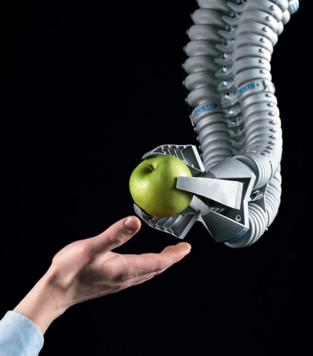
Festo Develops Innovative Robotic Arm Using Model-Based Design
Challenge
Design and implement a control system for a pneumatic robotic arm
Solution
Use Simulink and Simulink PLC Coder to model, simulate, optimize, and implement the controller on a programmable logic controller
Results
Complex PLC implementation automated
Technology and innovation award won
New business opportunities opened
The Festo Bionic Handling Assistant. Image © Festo AG.
“Using Simulink for Model-Based Design enables us to develop the sophisticated pneumatic controls required for the Bionic Handling Assistant and other mechatronic designs. With Simulink PLC Coder, it is now much easier to get from a design to a product.”
- Dr. Rüdiger Neumann, Festo
Link to user story
Notes:
Primary Industry: Industrial automation and machinery
Secondary Industries: NA
Product Capabilities: Mathematical modeling, System design and simulation, Embedded code generation
Applications: Embedded systems, Control systems, Mechatronics
Products Used: MATLAB, Simulink, Simulink Coder, Simulink PLC Coder
Country: Germany
Festo Develops Innovative Robotic Arm Using Model-Based Design
Inspired by the motion of an elephant’s trunk, Festo AG developed the Bionic Handling Assistant, a mechatronic arm that can work closely and safely with humans. Unlike industrial robotic arms, which are typically enclosed in safety cages to protect nearby workers, the Bionic Handling Assistant is designed to interact directly with humans. Incidental contact with the mechatronic arm is harmless because the arm is made of lightweight polymer components driven by compressed air. Also, the pneumatics are managed by a control system that yields immediately in the event of a collision.
Festo researchers developed the control system using MATLAB® and Simulink® for Model-Based Design, and then implemented it on a programmable logic controller (PLC) using Simulink PLC Coder™. “With Model-Based Design, we can model, simulate, optimize, and generate code to implement the controller all in the same tool environment,” says Dr. Rüdiger Neumann, head of the research department for mechatronic systems at Festo. “As a result, our development process is more efficient, not only for the Bionic Handling Assistant, but for any project that requires a controller implementation with code generation.”
The Challenge
With 11 degrees of freedom, the Bionic Handling Assistant is a complex system of 12 pneumatic chambers, 13 actuators, and 12 position sensors. The system’s 12 pressure controllers and 12 position controllers work in concert to control the motion of the arm, which weighs about four pounds (1.8 kg) and extends to 3.6 feet (1.1 meters). “Pneumatic systems are highly nonlinear and the trunk has elasticity, so we could not use simple PID controllers,” says Neumann. “To get optimal controller response, we needed active vibration damping and specialized nonlinear state-space models, with feedback and feedforward control structures.”
Festo’s research and development group is frequently asked to assess the feasibility of specialized customer applications. They traditionally developed and tested controllers for these applications on prototyping hardware. The process of creating a microcontroller solution for such a prototype, however, was time-consuming and therefore costly. “We wanted to use Festo’s own standard PLC products for real-time control without building new hardware for low-volume special controller applications,” says Neumann.
“Using Simulink for Model-Based Design enables us to develop the sophisticated pneumatic controls required for the Bionic Handling Assistant and other mechatronic designs. With Simulink PLC Coder, it is now much easier to get from a design to a product.”
- Dr. Rüdiger Neumann, Festo
The Solution
Festo developed the Bionic Handling Assistant controller using Simulink and implemented it in structured text on a Festo PLC using Simulink PLC Coder.
The researchers created plant and controller models in Simulink for the individual pneumatic chambers that make up the Bionic Handling Assistant, and ran simulations to verify controller functionality.
They generated C code from the model using Simulink Coder™. They compiled and deployed this code to prototyping hardware to conduct initial lab tests.
In MATLAB, the researchers performed system identification using measurements gathered during lab tests of the pneumatic arm to refine the plant model.
With a more accurate plant model in place, the team optimized the controller design in Simulink to improve its performance and stability.
They then used Simulink PLC Coder to generate IEC 61131 structured text from the optimized Simulink model of the controller. After importing the structured text into their 3S-Smart Software Solutions CoDeSys IDE, the team compiled and deployed it to a CMXR-C2 multi-axis controller from Festo.
To verify the PLC implementation, they compared its frequency response and time response against those of the Simulink model and the C code for the initial controller prototype. They performed additional iterations to improve performance by tuning the model in Simulink and regenerating structured text with Simulink PLC Coder.
The Bionic Handling Assistant has been demonstrated worldwide and has won innovation awards in Europe and North America. Festo is now using Simulink PLC Coder to develop other advanced mechatronic systems.
The Results
■ Complex PLC implementation automated. “On previous projects, we have written structured text by hand for the feedforward control, but it would be too complicated to implement feedback control of the Bionic Handling Assistant on a PLC using this manual approach—we simply would not have done it,” says Neumann. “Simulink PLC Coder enabled us to generate the structured text automatically in minutes.”
■ Technology and innovation award won. For its work on developing the Bionic Handling Assistant and enabling safer interactions between robots and humans, Festo was awarded the 250,000-euro Deutscher Zukunftspreis, the German President’s award for technology and innovation, which recognizes advances that serve mankind, improve lives, and create jobs.
■ New business opportunities opened. “In the past, it was prohibitively expensive to build the necessary controller hardware for specialized products,” notes Neumann. “With Simulink PLC Coder, we can easily implement our controller designs on our existing PLC hardware. This capability has enabled Festo to pursue new business opportunities for engineering low-volume controller products.”
Watch the YouTube video about the Bionic Handling Assistant
To learn more about Festo, visit www.festo.com

Slide 15

Iveco Develops a Shift Range Inhibitor System for Mechanical 9- and 16-Speed Transmissions in Six Weeks
Challenge
Develop and deliver an automotive transmission management system in six weeks
Solution
Use Model-Based Design to model, implement, test, and deploy the management system on a PLC
Results
Development time cut by 40%
Specification and implementation errors eliminated
PLC design reused on a microprocessor
An Iveco heavy-duty vehicle.
“Our system engineers work directly with our software engineers on the Simulink model. This speeds development because there is no misinterpretation of requirements. When we’re confident that the model is right, we save even more time by generating code from it, with no implementation errors.”
- Demetrio Cortese, Iveco
Link to user story
Notes:
Primary Industry: Automotive
Secondary Industries: N/A
Product Capabilities: System design and simulation, Embedded code generation
Applications: Embedded systems, Control systems
Products Used: MATLAB, Simulink, Embedded Coder, Simulink PLC Coder, Simulink Report Generator
Country: Italy
Iveco Develops a Shift Range Inhibitor System for Mechanical 9- and 16-Speed Transmissions in Six Weeks
To capitalize on a market opportunity in Latin America for a range of medium- to heavy-duty vehicles, Iveco had to design, implement, test, and deliver a shift range inhibitor system for vehicles with 9- and 16-speed transmissions in about six weeks. The aggressive deadline required a compressed software development schedule that left no room for specification or implementation errors.
Model-Based Design with Simulink® and Simulink PLC Coder™ enabled Iveco engineers to complete the transmission management system on schedule using existing programmable logic controller (PLC) hardware.
“Because we had so little time on this project, we could not use our usual development approach,” says Demetrio Cortese, embedded software manager at Iveco. “Instead, we adopted Model-Based Design and a custom workflow. Our system engineers and software engineers worked closely together using MATLAB and Simulink, which helped eliminate errors in requirements. The software engineers then generated the production code using Simulink PLC Coder, which accelerated development and minimized implementation errors.”
The Challenge
Due to the tight time constraints on the project, the team planned to use a preexisting hardware configuration that included a PLC. The software engineers, however, had no experience in writing structured text for PLCs. To avoid implementation errors and increased development time, Iveco needed to generate structured text automatically.
Iveco’s traditional approach, in which system engineers define requirements and specifications that are handed off to software engineers, was not feasible given the project’s short timeline. “To save time, we needed our system and software engineers to collaborate in defining and elaborating the system,” explains Cortese.
Engineers planned to reuse the system on other processor-based projects, so they needed a way to retarget the initial PLC design once it was completed.
“Our system engineers work directly with our software engineers on the Simulink model. This speeds development because there is no misinterpretation of requirements. When we’re confident that the model is right, we save even more time by generating code from it, with no implementation errors.”
- Demetrio Cortese, Iveco
The Solution
Iveco used MATLAB®, Simulink, and Simulink PLC Coder to develop, implement, and test the PLC version of the transmission management system.
Working together, system engineers and software engineers developed a preliminary model of the system in Simulink.
Software engineers refined and customized the model, adding constraints, data types, built-in tests, and diagnostics. They simulated the model in Simulink to verify the design’s integrity and to identify overflow conditions, unexercised blocks, and other potential issues.
The team generated structured text from the model using Simulink PLC Coder. They integrated this structured text into the supplier’s PLC development environment, and deployed the system to a PLC running on a test bench.
The engineers conducted real-time lab tests using the PLC and the actual transmission, quickly adjusting the model, regenerating the code, and rerunning tests until the management system met its functional and performance requirements.
The verified system was then deployed to an actual vehicle for on-road tests. The team continued to fine-tune the system in the field, using Simulink and Simulink PLC Coder to quickly update and redeploy the software between tests.
With Simulink Report Generator™, the team generated the documentation for the system.
The PLC version of the management system is entering production on Iveco vehicles for the Latin American market. The engineering team is reusing the Simulink model with Embedded Coder™ to deploy the system on a Master Vehicle Computer.
The Results
■ Development time cut by 40%. “We delivered the software in less than 35 days and used the remaining time for road testing,” says Cortese. “Model-Based Design has enabled us to reduce time-to-delivery of new software systems by about 40%.”
■ Specification and implementation errors eliminated. “With Simulink we create an executable specification: one model that is used by system engineers and software engineers. Close cooperation between these engineers reduces specification errors,” notes Cortese. “With Model-Based Design we have also eliminated implementation errors, because we automatically generate production code.”
■ PLC design reused on a microprocessor. “After implementing the PLC version with Simulink PLC Coder, we reused the model, with few modifications, and generated the microprocessor code using Embedded Coder,” says Cortese. “We switched from a structured text implementation to C, just by changing the code generation product we used.”
To learn more about Iveco, visit www.iveco.com

Slide 16
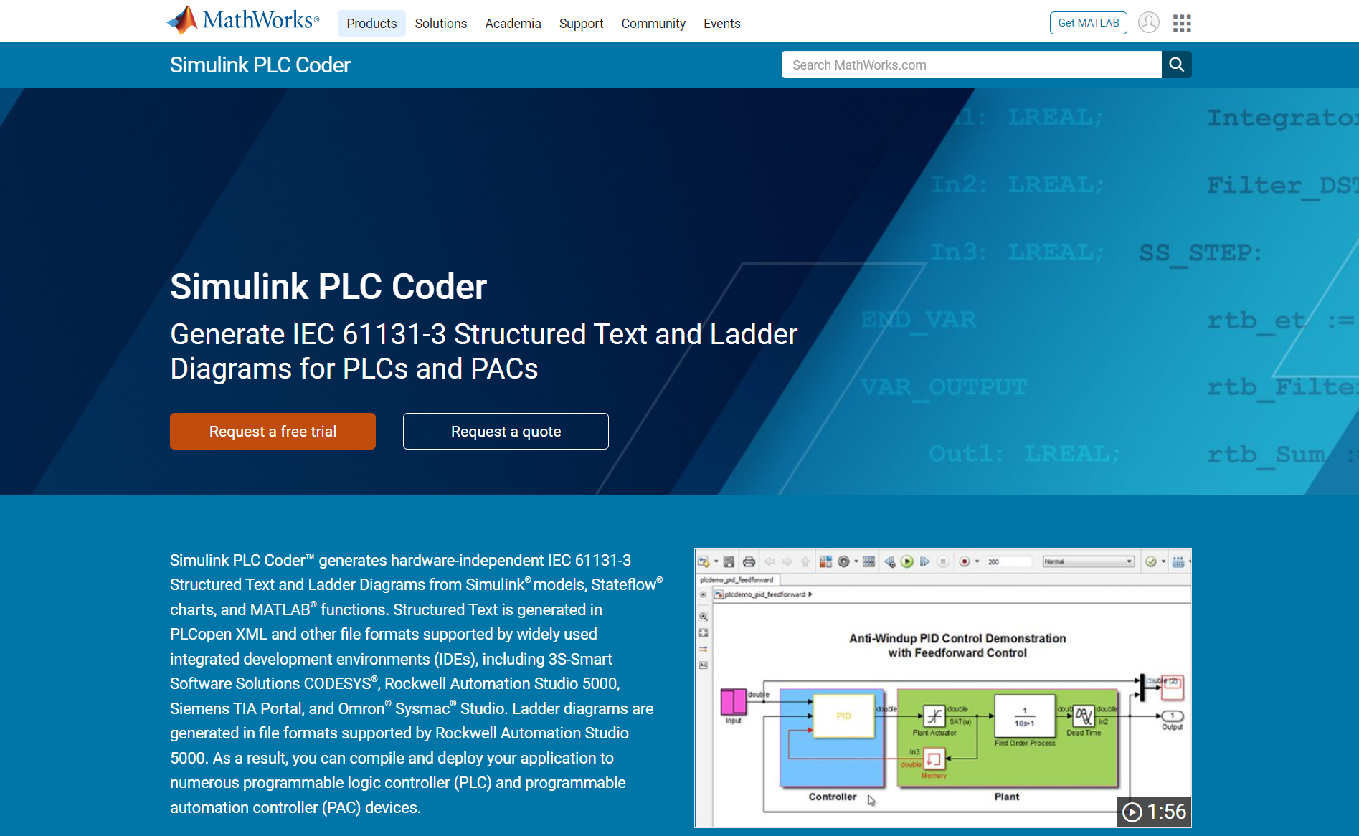
Summary
Simulink PLC Coder
Generates IEC 61131-3 Structured Text and Ladder Diagrams
Supports various IDEs
Provides verification support including test benches
Visit the product website for more information

